Slide 1









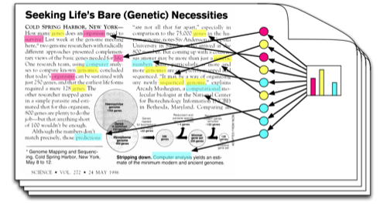

Classification and Analysis of Public Comments to Rulemaking
Arthur Pignotti
Health Insurance Specialist
CMS
Background on Comment
Review Process
Stakeholders: Staff, SMEs, Leadership
Step 1: Post Proposed Rule
Step 2: Receive Public Comments
Step 3: Sort & Review Comments
Step 4: Brief Leadership & Get Decisions
Step 5: Write & Publish Final Rule
Customer Need: Automate Tasks
to Spend More Time on Complex Tasks
Reduce the Time to Sort,
Convert, and Read +1,000 Pages
of Comments
Quickly Brief Leadership to
Maintain Tight Deadlines
Solution: Topic Modeling Process
to Automate Tedious Tasks
Use Proposed Rule Text to Train Topic Model
Automate the Conversion of Comments into Machine Readable Text
Use Topic Model to Classify Public Comments by Proposed Rule Section
Benefits
Automate tedious tasks = more time for important tasks
Briefing sooner = earlier decisions
More time to analyze tougher decision points
Identify write-in campaigns and duplicate submissions
Alternatives
CAAT on FDMS
SAS Text Miner
SAS Contextual Analysis
Manual Review

